Slide 1
Chat to X
eWallet P2P Agent Messaging
Documentation and Capabilities

Slide 2

Project Goals
Unpack, identify and document the mechanisms that enable P2P encrypted communication in the Fetch.ai wallet browser extension.
Why:
Provides a basis for a future connected car interface
Cryptographic bedrock upon which connected car communication should be built up.
Enables prototyping capabilities for in-car human support and assistance
Documentation empowers users to communicate with agents representing infrastructure and also with other users who support access to such infrastructure.

Slide 3

Functionalities Unpacked and Documented
Addressing, encryption, and mailbox functionalities:
P2P Chat:
Programmatic P2P chat in python
Mobile P2P chat (MOBIX Wallet)
Group Chat
GPT large language model (LLM)
Limited programmatic access (auth gated)
Fetch.ai Bot µAgent functionalities:
Asset transfers / one time payments
Staking operations
Recurring payment
Limited programmatic access (auth gated)
Static "/commands"

Slide 4

P2P Wallet Chat Documentation Walkthrough
Desktop Programmatic Chat Libraries and Examples:
Wallet / user based messaging: https://github.com/fetchai/fetch-wallet/blob/master/messaging.md
A Babble python client library for sending messages via the Memorandum service: https://github.com/fetchai/babble
Example usage for Babble: https://github.com/fetchai/babble/blob/main/examples/simple-e2e.py
Extended Functionality Available in Browser Extension Wallet:
https://github.com/fetchai/fetch-wallet:
Contains additional functionality for creating groups, registering groups and register a symmetric key for group users for the group E2E encryption
Contains code for parsing Static "/commands"
Open Source

Slide 5
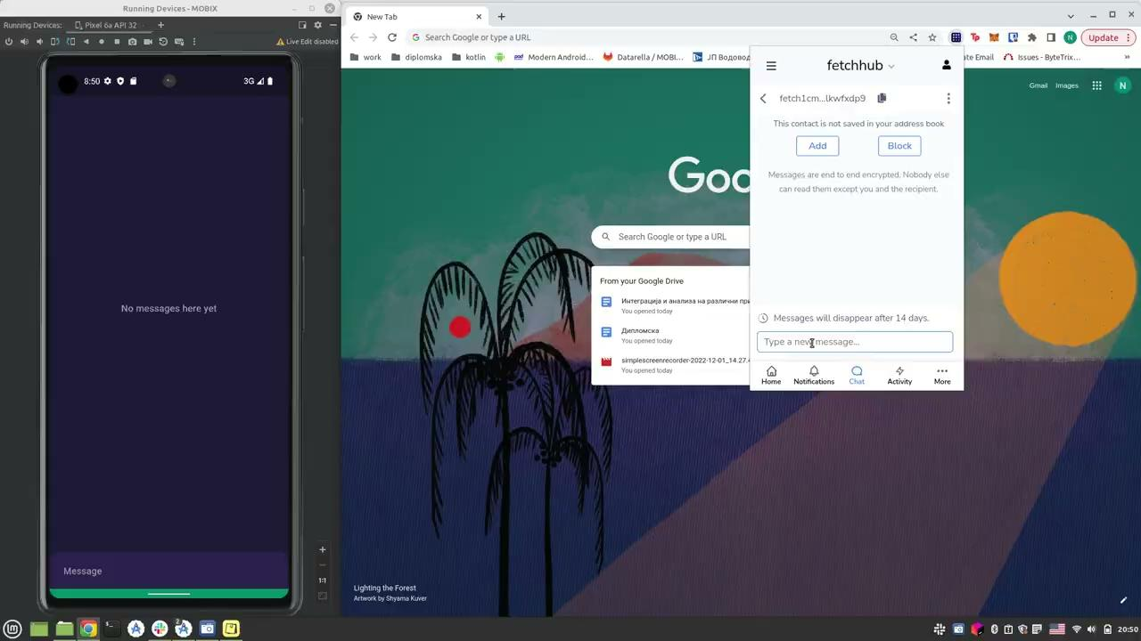
Mobile App Based P2P Wallet Chat
MOBIX Wallet Implementation: - Beyond state of the Art
E2E encrypted chat between MOBIX Wallet users without leaving app.
E2E encrypted chat between MOBIX Wallet users and Fetch browser extension wallet users.
Translation of the Babble library into a Dart library for Flutter:
Wrapper on top of the GraphQL queries;
Handles communication with the Fetch.ai chat service, called the Memorandum service.
Cryptographic signatures
Allows to use both the development & production versions of the Memorandum service.
Currently closed source

Slide 6
Mobile App Based P2P Wallet Chat
Improvements include features not available on Babble libraries but can be found in Fetch.ai Wallet extension (WIP):
Async messaging w/ GraphQL subscriptions eliminates manual filtering and facilitates notifications
Notifications for chat messages on the mobile applications
Group chats
Possible Future Work:
MOBIX wallet app to Agentverse Agent Chats
MOBIX wallet app to local agent chats
MOBIX wallet app to Fetchbot "/comands"
MOBIX wallet app chat to AI Engine via API
Voice input / output
Semantic parsing of user intent via LLM
Currently closed source

Slide 7
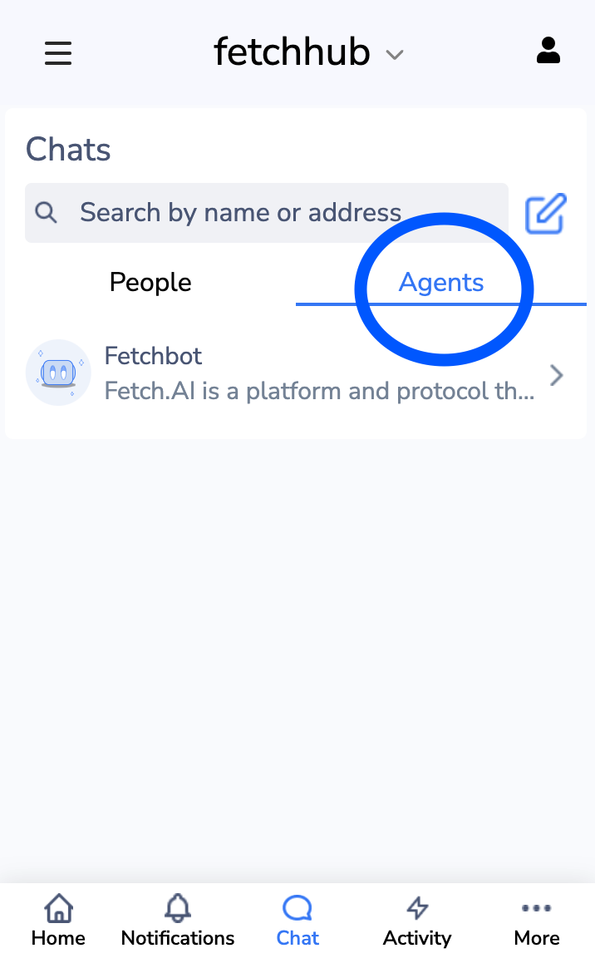
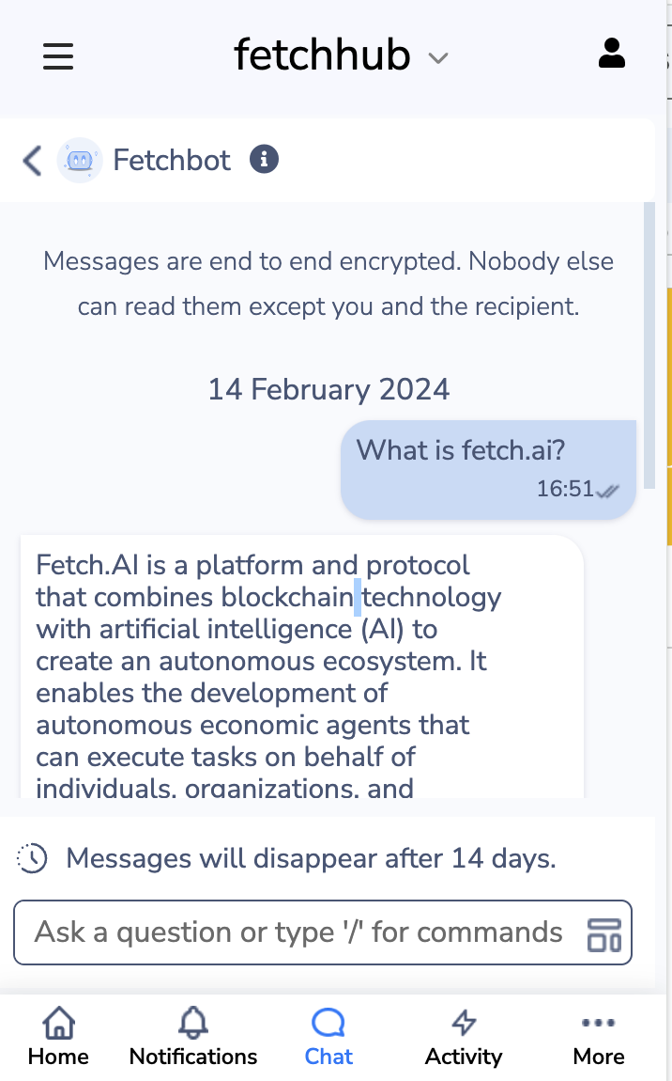
What is Fetchbot?
Fetchbot is a specific agent service hosted by Fetch.ai in the browser extension wallet
Two major functionalities:
Limited API calls to trained GPT 3.5 for general purpose chat *authgated
Service that parses "/commands" (not semantically).
Open Source

Slide 8
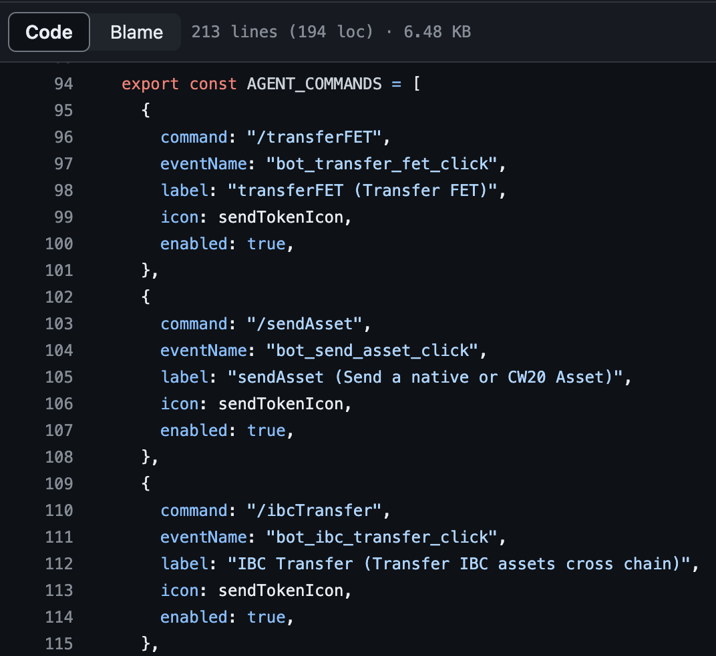

Fetchbot Approach for static "/commands"
https://github.com/fetchai/fetch-wallet/blob/master/packages/fetch-extension/src/config.ui.var.ts
Fetchbot listens to a limited number of "/commands" and acts on them in a predefined manner.
Open Source

Slide 9

Three types of Agents
Local agent (100% python syntax) ✅
Offline tolerant version of agentverse agents proxied through a mailbox (100% python syntax) ✅
Hosted agent ✅

Slide 10
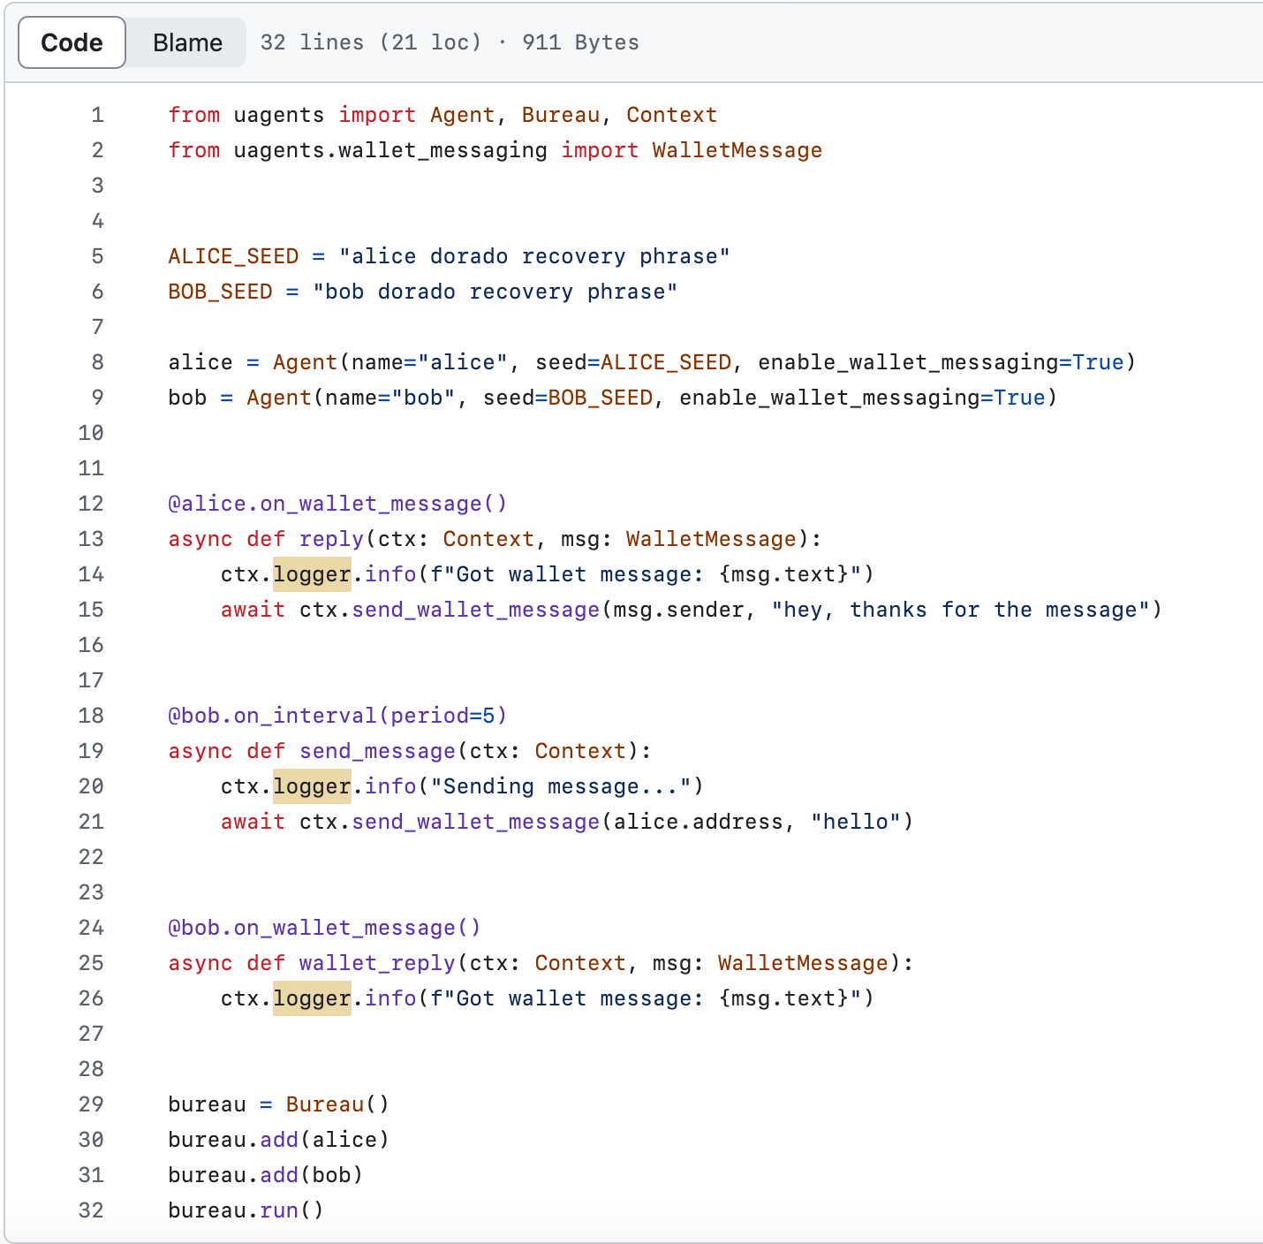
The Power of Wallet to Agent Chat (Experimental)
https://github.com/fetchai/uAgents/blob/main/python/examples/15-wallet-messaging/main.py
Agents to agent communication is built in (they spin up their own servers and use almanac contracts to do lookup)
Agent libraries includes client code to send messages through the memorandum server (to either MOBIX wallet or browser extension wallet). Meaning that an agent doesn't have to use the babble library.
Wallets can talk to Agents and vice versa via memorandum server

Slide 11
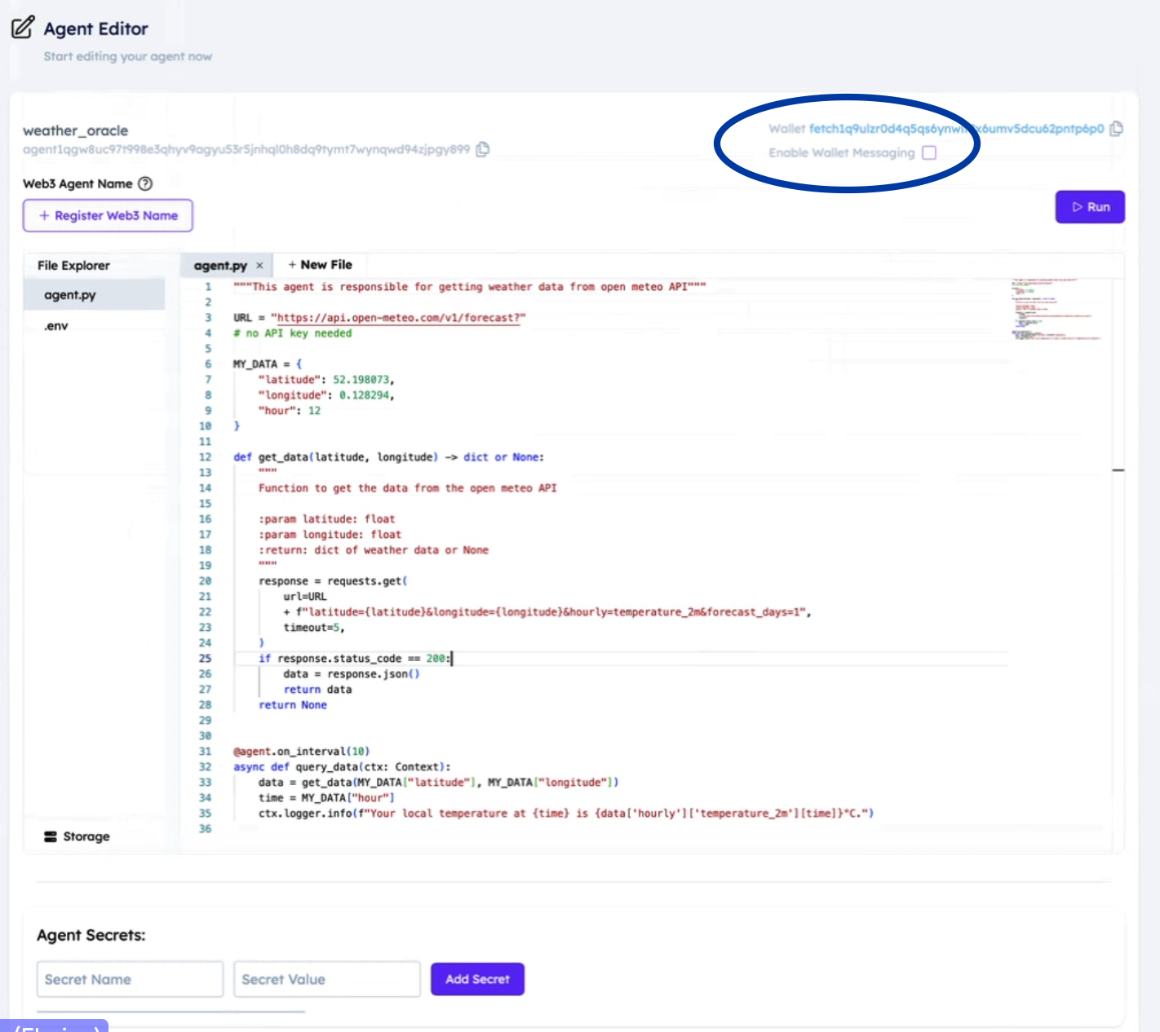
Wallet to Agentverse Agents Chat (Experimental)
Agentverse Agents Make This Easy:
Addressable from wallet messaging clients
Identified wallet using public key
Now built into Agentverse
Perfect for quick prototyping

Slide 12
Summa Summarum
The fetch browser extension pioneered a bunch of basic functionalities necessary for human to human and human to infrastructure communication anchored to the Bosch eWallet.
With this documentation the features are no longer a black box and can be actively used as a toolbox for eWallet development with future interfaces to LLM and voice services.

